Slide 1
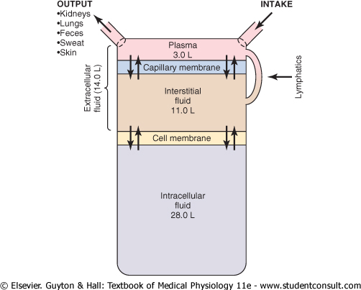

Slide 2
Daily intake and output of water (ml/day)
Normal
Maximum
Intake
Fluid ingested 3 100 infinity
From metabolism 300
Total intake 3 400
Output
Insensible – skin 350 5 000
Insensible – lungs 350 (vapor pressure 47 mmHg) 850
Sweat 150 5 000
Feces 100 7 000
Urine 2 400 infinity
Total output 3 400

Slide 3
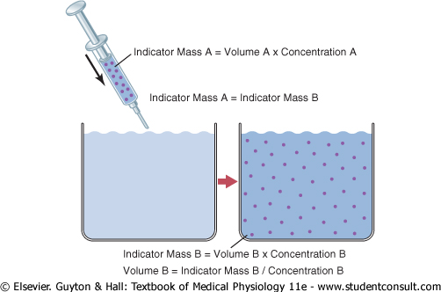
Notes:
3

Slide 4
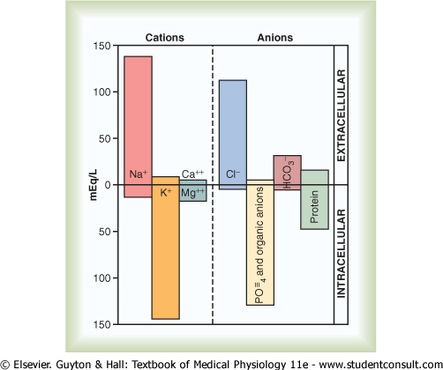

Slide 5
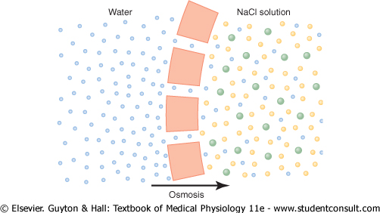
Osmosis is the net diffusion of water across a selectively permeable membrane
from a region of high water concentration to one that has a lower water concentration

Slide 6
Importance of Number of Osmotic Particles in Determining Osmotic Pressure
Osmotic pressure is determined by the number of particles per volume of fluid, not
by the mass of the particles.
each particle in a solution, regardless of its mass, exerts, on average the same amount
of pressure against the membrane.
k = kinetic energy
m = mass
v = velocity
m . v²
k =
2
Therefore, 1 mole of glucose in each liter has a concentration of 1 osm/L (even if 180 g/mol)
1 mole of sodium chloride has an osmolar concentration of 2 osm/L (even if 58.5 g/mol)
Thus, the term osmole refers to the number of osmotically active particles in a solution
rather that to the molar concentration.
Osmolality = when concentration is expressed as osmoles per kilogram of water
Osmolarity = is expressed as osmoles per liter of solution

Slide 7
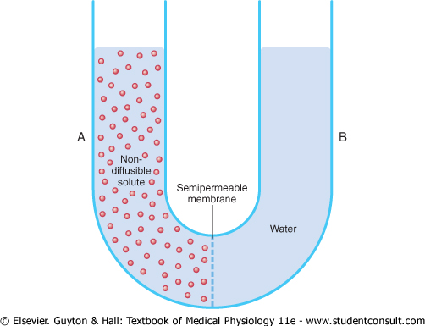
cm H₂O
The exact amount of pressure required to stop osmosis is called
the osmotic pressure of the solution.

Slide 8
Relation of Osmolality to Osmotic Pressure
A concentration of 1 osmole/L will cause 19 300 mmHg osmotic pressure
1 milliosmole/L is equivalent to 19.3 mmHg
Physiologically body fluids 300 mOsm/L = 5790 mmHg total osmotic pressure
Corrected osmolar activity (osmotic coefficient) = 0.93
The reason for this correction is that cations and anions exert interionic attraction, which
Can cause a slight decrease in the osmotic „activity“ of the dissolved substance
Calculation of the Osmolarity and Osmotic Pressure of a Solution
(by using van´t Hoff´s law)
0.9 % NaCl = 9 g NaCl per liter. Molecular weight of sodium chloride is 58.5 g/mol, the molarity
of solution is 9 g/L divided by 58.5 g/mol = 0.154 mol/L.
The osmolarity is 2 x 0.154 = 0.308 osm/L = 308 mOsm/L
308 mOsm/L x 0.93 (osmotic coefficient) = 286 mOsm/L is the actual osmolarity of 0.9 % NaCl

Slide 9
Plasma (mOsm/L H₂O) Interstitial Intracellular
Na⁺ 142 139 14
K⁺ 4.2 4 140
Mg²⁺ 1.3 1.2 0
Cl⁻ 108 108 4
HCO₃⁻ 24 28.3 10
HPO₄²⁻, H₂PO₄⁻ 2 2 11
SO₄²⁻ 0.5 0.5 1
Amino acids 2 2 8
Phosphocreatinine 45
Carnosine 14
Creatine 0.2 0.2 9
Lactate 1.2 1.2 1.5
Adenosine triphosphate 5
Hexose monophosphate 3.7
Glucose 5.6 5.6
Protein 1.2 0.2 4
Urea 4 4 4
Others 4.8 3.9 10
Total mOsm/L 301.8 300.8 301.2
Corrected osmolar activity 282.0 281.0 281.0

Slide 10
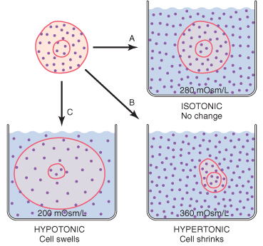

Slide 11
Calculations of Fluid Shifts and Osmolarities After Infusion of Hypertonic Saline
If 2 liters of a hypertonic 3.0 % NaCl solution are infused into the extracellular
fluid compartment of a 70 kg patient whose initial plasma osmolarity is 280 mOsml/l, what
would be the intracellular and extracellular fluid volumes and osmolarities after reaching
osmotic equilibrium?
Assuming that extracellular fluid volume is 20 % and intracellular fluid volume 40 %
of the body weight.

Slide 12
Initial Conditions
Volume Concentration Total
(liters) (mOsm/l) (mOsm)
Extracellular fluid 14 280 3 920
Intracellular fluid 28 280 7 840
Total body fluid 42 280 11 760
2 L of 3 % NaCl = 30 g NaCl per liter. Because the molecular weight is 58.5 g/mol.
This mean there is about 0.513 mole of NaCl per liter (30:58.5).
For 2 liters of solution this would be 1.026 mole (2 x 0.516).
Because 1 mole of NaCl equals 2 osmoles = 2 x 1.026 = 2.052 osmoles = 2 052 mOsm

Slide 13
Instantaneous Effect of Adding 2 Liters of 3.0 % NaCl
Volume Concentration Total
(liters) (mOsm/l) (mOsm)
Extracellular fluid 16 373 5972
14 + 2 5972 : 16 3920 + 2052
Intracellular fluid 28 280 7 840
Total body fluid 44 no equilibrium 13 812
Final osmolarity after reaching equilibrium must be: 13 812 : 44 = 313.9 mOsm/L

Slide 14
Effect of Adding 2 Liters of 3.0 % NaCl after Osmotic Equilibrium
Volume Concentration Total
(liters) (mOsm/l) (mOsm)
Extracellular fluid 19.02 313.9 5 972
5 972:313.9
Intracellular fluid 24.98 313.9 7 840
7 840:313.9
Total body fluid 44 313.9 13 812
13 812:313.9
One can see that adding 2 liters of hypertonic NaCl solution causes more tha 5-liters increase
in extracellular fluid volume (19.02 – 14 = 5.02), while decreasing intracellular fluid volume by
3 liters (24.98 – 28 = -3.02).

Slide 15
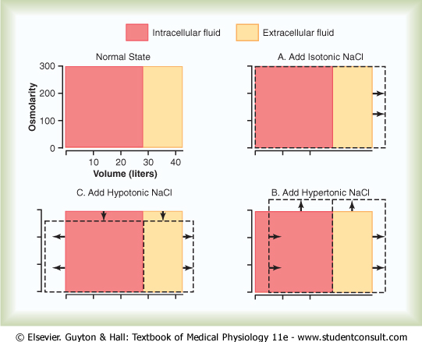
Notes:
15

Slide 16
Abnormality Cause Plasma Na⁺ ECFV ICFV
Concentration
Hyponatremia Adrenal insuffficiency
Dehydration overuse of diuretics
vomiting and diarrhea
Hyponatremia Excess ADH (SIADH)
Overhydratation
Hypernatremia Diabetes insipidus
Dehydration excessive sweating
(without water intake)
Hypernatremia Cushing´s disease
Overhydration primary aldosteronism
C

Slide 17
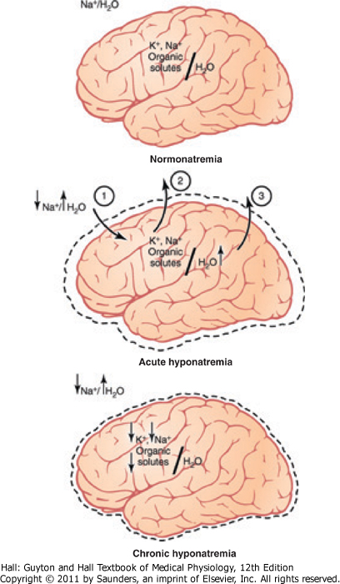

Slide 18
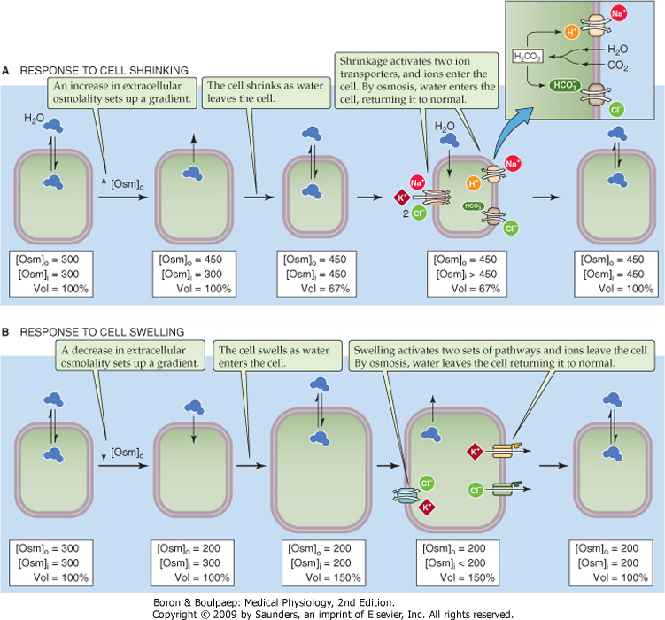
Regulatory volume
Increase
(brain)
(acute – salts)
(chronic – organic solutes - sorbitol)
Regulatory volume
decrease

Slide 19
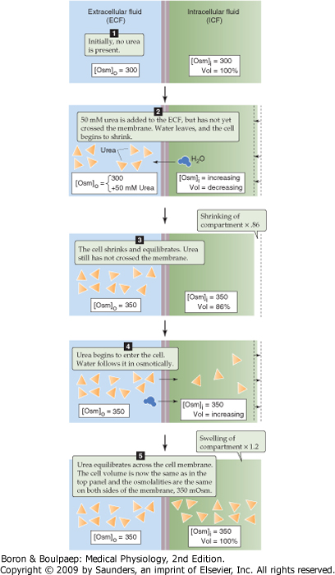

Slide 20
Kidneys serve following functions:
Excretion of metabolic waste products and foreign chemicals
Regulation of water and electrolyte balance
Regulation of body fluid osmolality
Regulation of acid-base balance
Metabolism of hormones
Gluconeogenesis

Slide 21
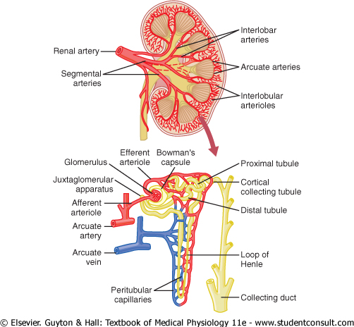

Slide 22
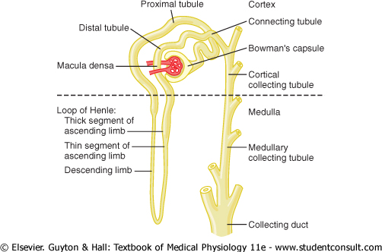

Slide 23
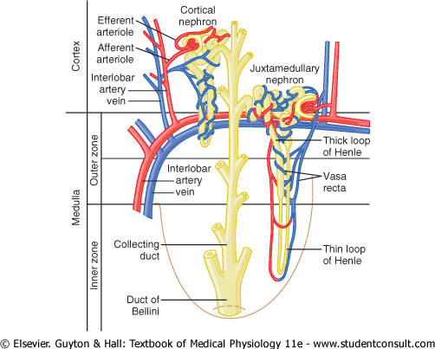

Slide 24
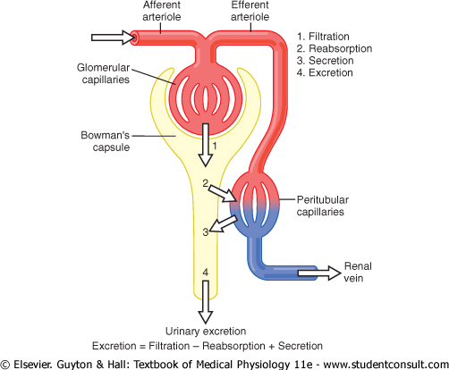

Slide 25
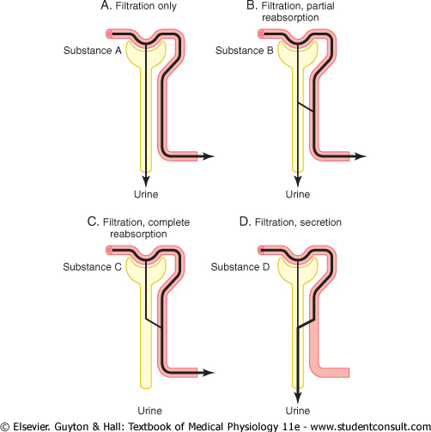

Slide 26
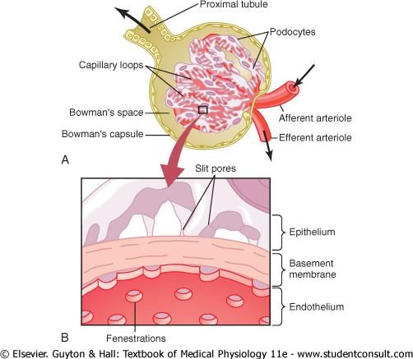

Slide 27
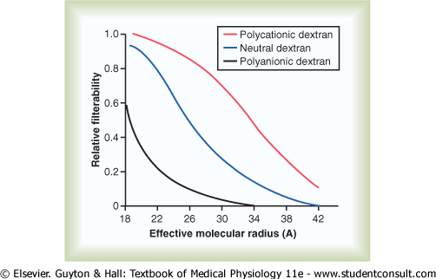

Slide 28
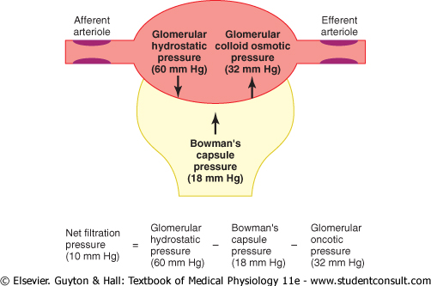

Slide 29
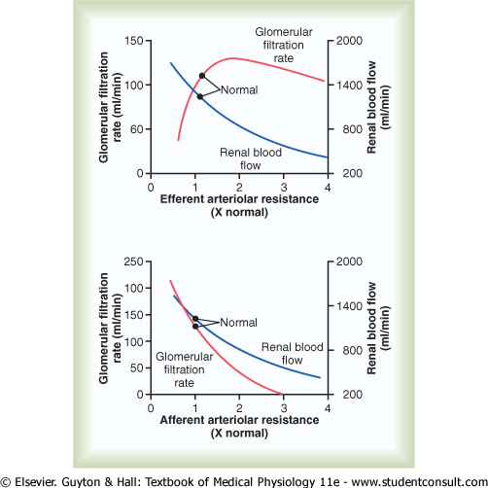
Notes:
29

Slide 30
GLOMERULÁRNÍ KAPILÁRY
GLOMERULÁRNÍ FILTRACE
PRŮTOK KRVE LEDVINAMI
Aferentní arteriola
Eferentní arteriola
P_{GC}
Vazokonstrikce aferentní arterioly
P_{GC}
Vazokonstrikce eferentní arterioly
P_{GC}

Slide 31
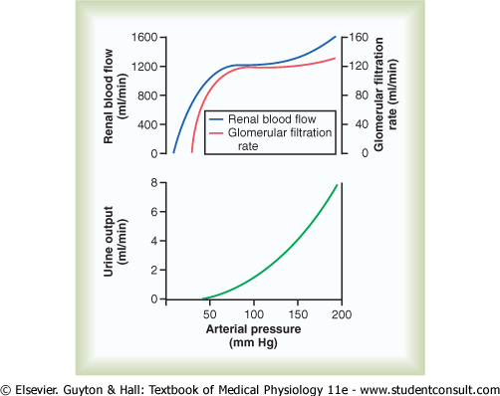

Slide 32
Autoregulation of Glomerular Filtration Rate and Renal Blood Flow
Myogenic Mechanism
Tubuloglomerular Feedback

Slide 34
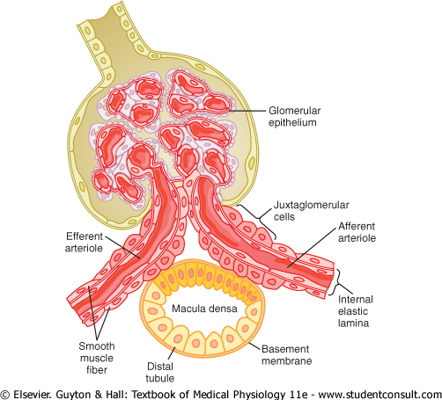

Slide 37
Use of Clearance Methods to Quantify Kidney Function
Renal clearance of a substance is the volume of plasma that is
completely cleared of the substance by the kidneys per unit time

Slide 38
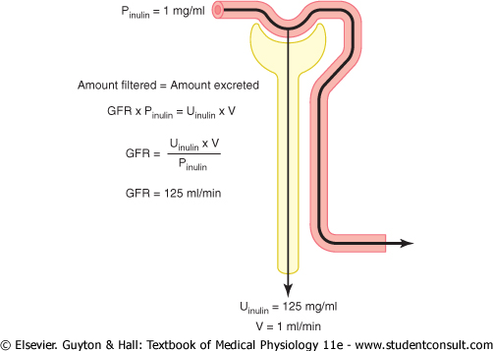

Slide 39
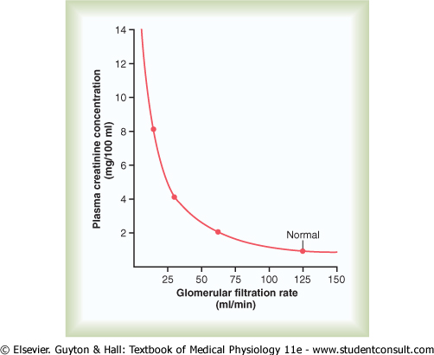

Slide 40
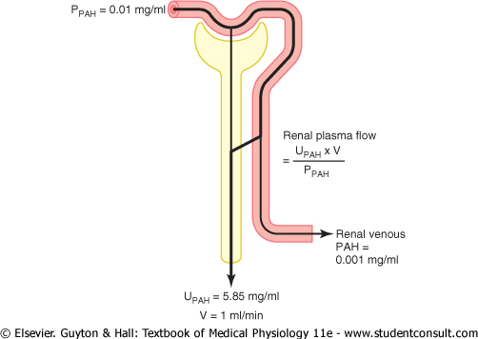

Slide 41
Tubular Processing of the Glomerular Filtrate
Urinary excretion = Glomerular Filtration – Tubular reabsorption
+ Tubular Secretion
The processes of glomerular filtration and tubular reabsorption are
quantitatively very large relative to urinary excretion for many substances.
Unlike glomerular filtration, tubular reabsorption is highly selective.

Slide 42
Filtration, Reabsorption and Excretion Rates of Different Substances by the Kidneys
Amount Amount Amount % of Filtered
Filtered Reabsorbed Excreted Load Reabsorbed
Glucose 180 180 0 100
(g/day)
Bicarbonate 4 320 4 318 2 99.9
(mmol/day)
Sodium 25 560 25 410 150 99.4
(mmol/day)
Chloride 19 440 19 260 180 99.1
(mmol/day)
Potassium 756 664 92 87.8
(mmol/day)
Creatinine 1.8 0 1.8 0
(g/day)

Slide 43
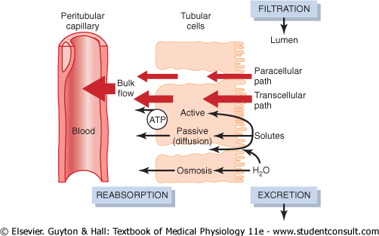

Slide 44
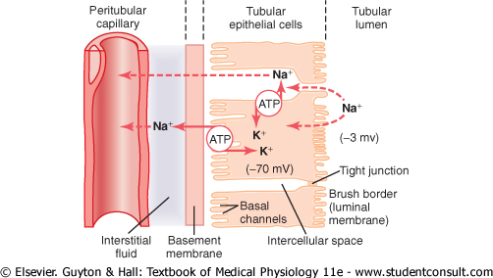

Slide 45
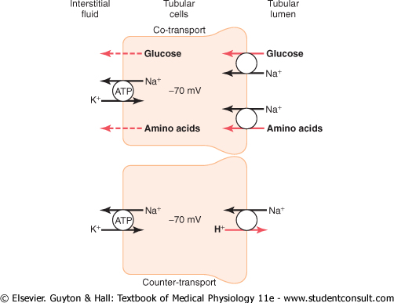

Slide 46
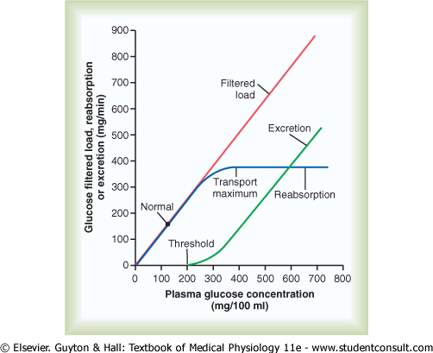

Slide 47
Comparison of sodium and water reabsorption along the tubule
Percent of filtered load reabsorbed (%)
Tubular segment Sodium Water
Proximal tubule 65 65
Descending thin limb of Henle´s loop 0 10
Ascending thin limb and thick 25 0
ascending limb of Henle´s loop
Distal convoluted tubule 5 0
Collecting-duct system 4-5 5 (during water-loading)
>24 (during dehydration)

Slide 48
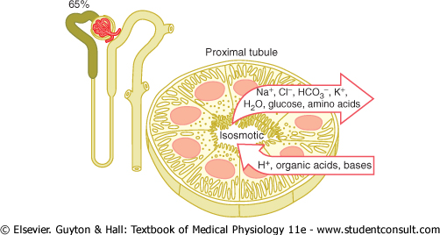

Slide 50
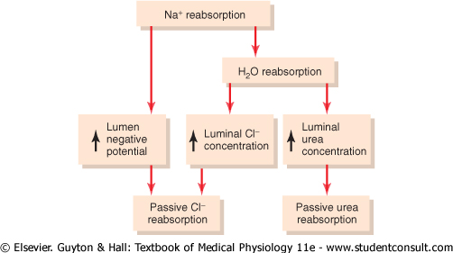

Slide 51
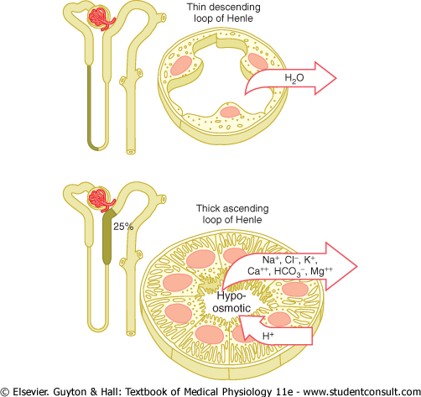

Slide 52
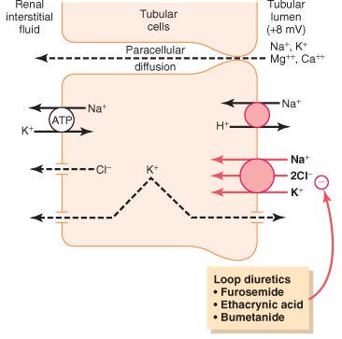

Slide 53
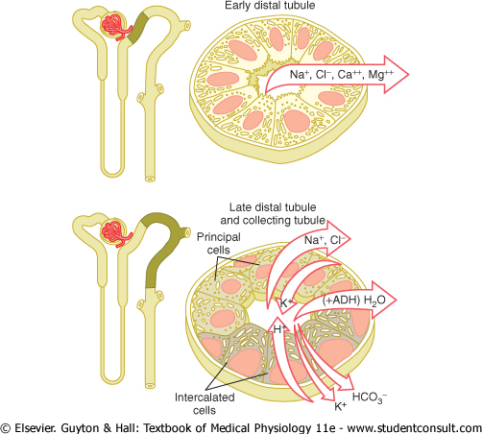

Slide 54
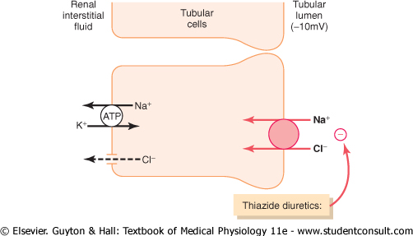

Slide 56
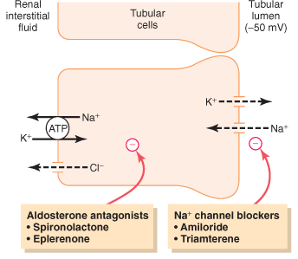

Slide 57
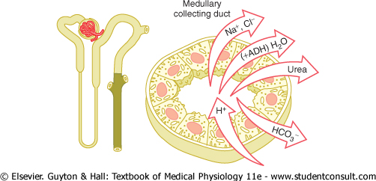

Slide 58
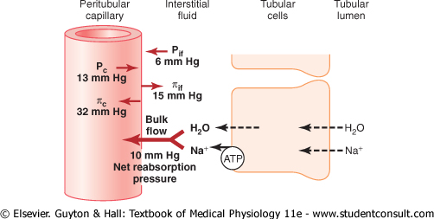

Slide 59
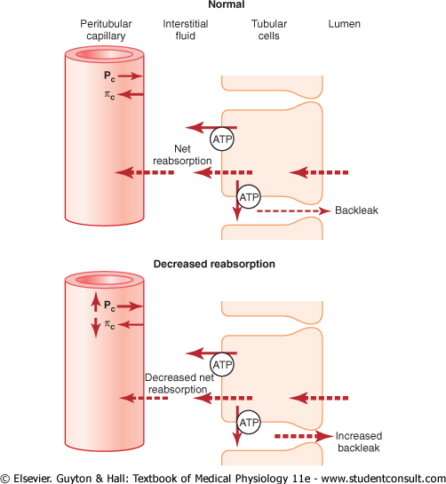

Slide 60
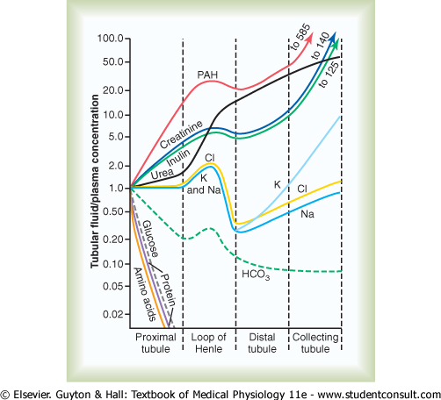

Slide 61
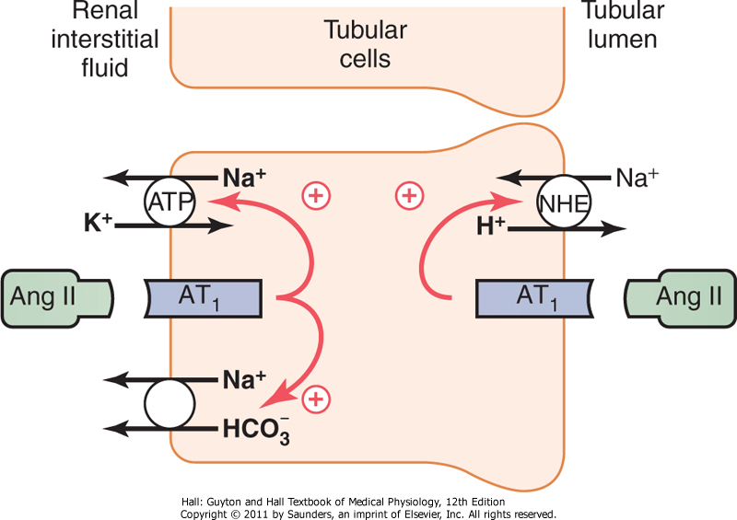
Downloaded from: StudentConsult (on 3 January 2014 11:22 AM)
Notes:
61

Slide 62
Renal Regulation of Potassium Balance

Slide 63
2.3 RT [C₁]
E_{ion} = log₁₀
zF [C₂]
60 mV 100
E_{ion} = log₁₀
1 10
= 60 mV x log₁₀ 10
= 60 mV x 1
= 60 mV (or -60 mV, cell interior negative)
E_{ion} = the electrical potential (mV)
R = natural gas constant
T = the absolute temperature (⁰K)
z = the valence of the ion
F = the Faraday constant (96 500 colombs/mol)
C_{1 (in)} = the concentration of the ion inside the cell (mmol/L)
C₂ _{(out)} = the concentration of the ion outside the cell (mmol/L)
2.3 RT/F = 60 mV at 37⁰C
60 mV 100
E_{ion} = log₁₀
1 4
= 60 mV x log₁₀ 25
= 60 mV x 1.40
= 84 mV (or -84 mV, cell interior negative)
60 mV 100
E_{ion} = log₁₀
1 1
= 60 mV x log₁₀ 100
= 60 mV x 2
= 120 mV (or -120 mV, cell interior negative)
Decreased serum K⁺ concentration „hyperpolarize“ the resting membrane
potential and therefore „firing“ action potentials becomes more difficult

Slide 64
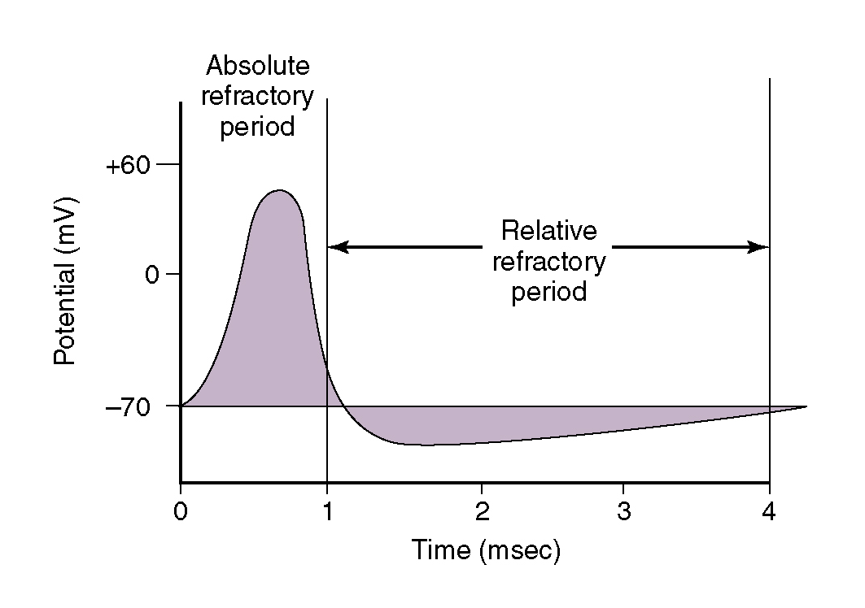

Slide 65
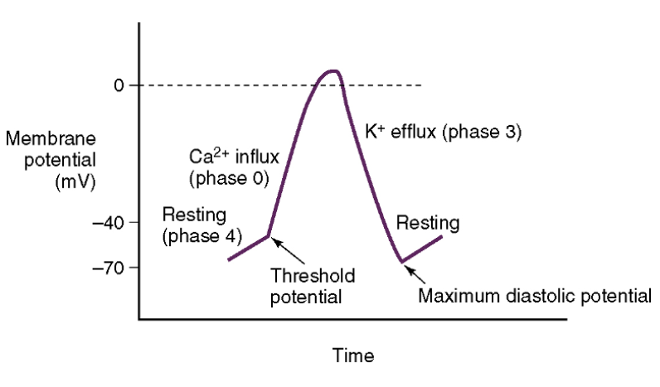

Slide 66
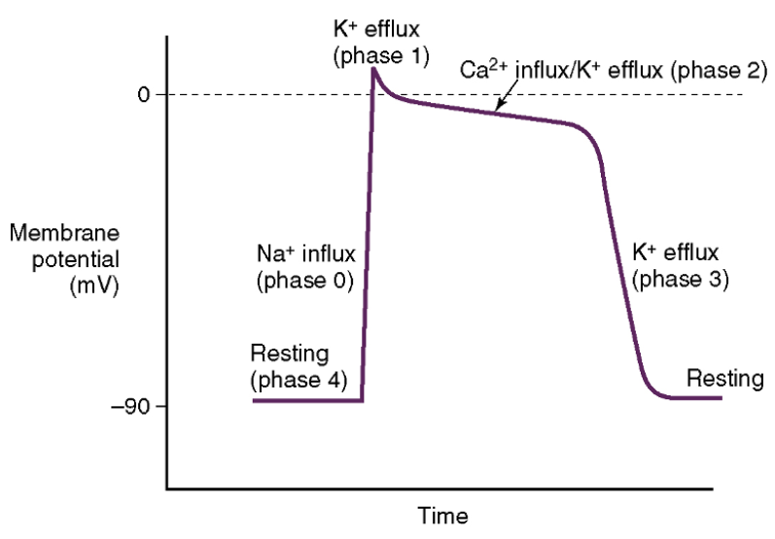

Slide 67
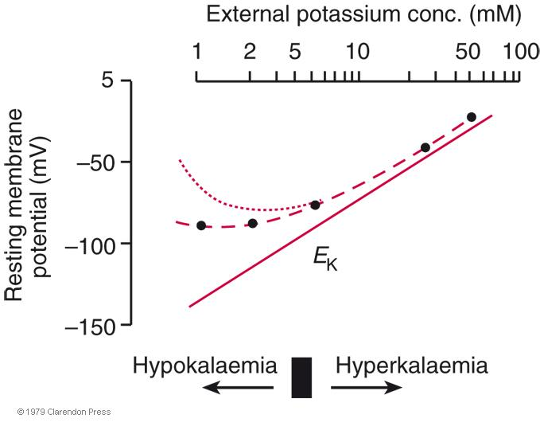
Hyperkalemia
Reduces the Nerns K⁺ equilibrium potential
and therefore the resting membrane potential
2.3 RT [C₁]
E_{K} = - log₁₀
zF [C₂]
2.3 ET/F (60 mV at 37⁰ C)
60 [100]
E_{K} = - log₁₀
1 [4]
= 60 x log₁₀ 25
= 60 x 1.4
= 84 mV (or -84 mV, interior
cell is negative)
60 [100]
E_{K} = - log₁₀
1 [1]
= 60 x log₁₀ 100
= 60 x 2
= 120 mV (or -120 mV)
60 [100]
E_{K} = - log₁₀
1 [10]
= 60 x log₁₀ 10
= 60 x 1
= 60 mV (or -60 mV)

Slide 68
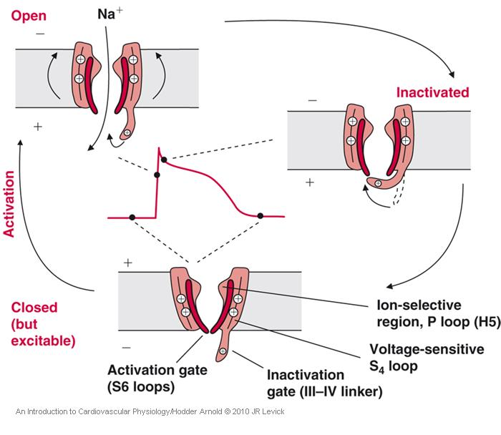
Reduced resting membrane potential
diminishes the action potential, because
the low resting potential prevents many
Na⁺ channels from reseting from the
Inactivated state to the closed-but –activatable state

Slide 69
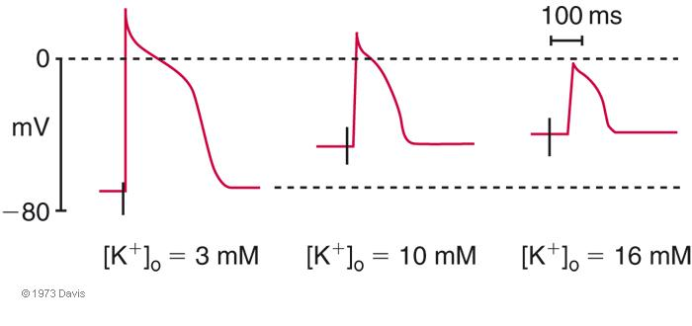
As a result the action potential begins to lose its sharp phase 0, and is eventually reduced to a sluggish rise of small amplitude
dependent on I_{ca-L}

Slide 70
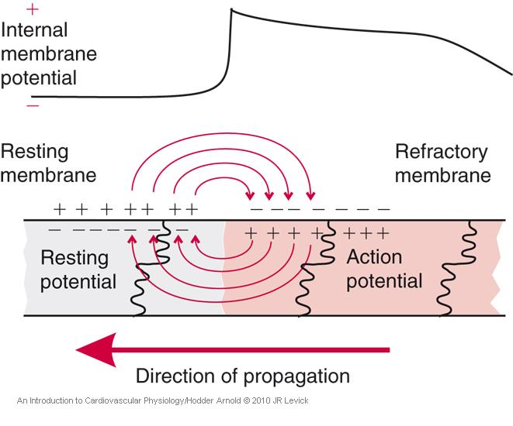
Small, slow-rising action potentials generate less propagating current, electrical transmission is slower and less secure.
This can lead to heart block or a pathological ventricular tachycardia/fibrilation.

Slide 71
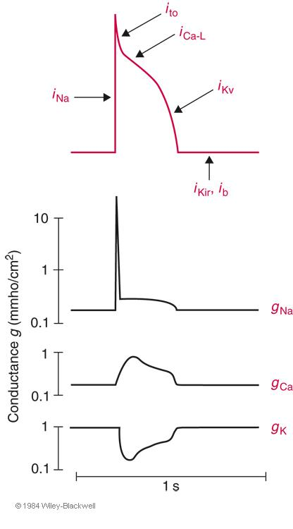
The raised extracellular K⁺ also stimulates the 3Na⁺-2K⁺ pump,
enhances the activity of K⁺ channels K_{ir} and K_{v}, causing early repolarization.
Wide QRS is likely due to slow electrical propagation in the ventricle
Tall, peaked T wawe is likely due to enhanced repolarization K⁺ current
(similar changes occur in ischameic myocardium)
Hypokalemia
The low extracellular K⁺ also reduces the activity of the 3Na⁺-2K⁺ pump,
and the activity of K⁺ channels K_{ir} and K_{v}, causing prolonged repolarization.
This is particularly true in K_{v} rich subepicardial myocates.
Prolongation of the subepicardial action potentials leads to flattened or even
Inverted T wawes, which are called a U wawe.

Slide 72
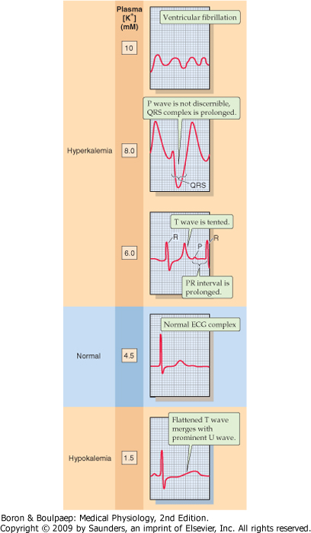

Slide 73
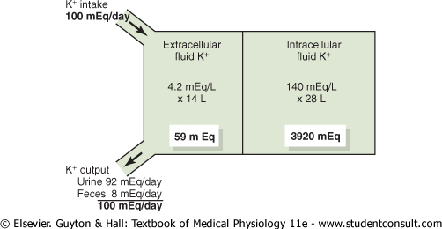
Notes:
73

Slide 76
3 Na⁺
K⁺
2 K⁺
ATP
GLUT4
glukóza
Mineralo- kortikoidní receptor
Inzulínový receptor
inzulín
cAMP
Adrenalínový receptor
aldosteron
adrenalin
aldosteron

Slide 78
Summary of tubular potassium transport
Normal- or high-potassium Low-potassium
Tubular segment diet diet
Proximal tubule Reabsorption (60-80 %) Reabsorption (55 %)
Thick ascending limb Reabsorption (5-25 %) Reabsorption (30 %)
Distal convoluted tubule Secretion Reabsorption
Cortical collecting duct Substantial secretion 0
(Principals cells) (15-180 %)
Cortical collecting duct Reabsorption (10 %) Reabsorption (10 %)
(Intecalated cells, type A)
Medullary collecting duct Reabsorption (5 %) Reabsorption (5 %)

Slide 80
Lumen
Intersticiální Prostor
ENaC
Na⁺
K⁺
K⁺
K⁺
3 Na⁺
Cl⁻
2 K⁺
ATP
Hlavní Buňka
„principal cell“
Sběracího
Kanálku

Slide 81
Lumen
Vmezeřená buňka
„intercalated cell“
Sběracího kanálku
Intersticiální Prostor
3 Na⁺
2 K⁺
H⁺
ATP
HCO₃⁻
ATP
Cl⁻
K⁺
H⁺
K⁺
Cl⁻
ATP

Slide 82
Homeostatic Control of Potassium Secretion by the Cortical Collecting Duct
(3 key factors)
Plasma concentration of potassium
Plasma levels of aldosterone
Delivery of sodium to the distal nephron
Ad.1:
The principal cells contains an isoform of Na-K-ATPase that is especially sensitive
to increases in the concentrations in peritubular capillaries. It also reduces back leakage
Potasium ions from inside the cells through the basolateral membrane.
Ad.2:
The luminal membrane pathway that allows potassium to exit the cell must be open and
this is the function of aldosterone. It also stimulates Na-K-ATPase.
Ad.3:
With an increased delivery of sodium to the cortical collecting duct, more sodium
enters principal cells, and more potassium is secreted.
4. Acute acidosis decreases potassium secretion
The primary mechanism is that increased hydrogen ion concentration reduces
the activity of Na-K-ATPase pump. This in turn decreases intracellular potassium
concentration and subsequent passive diffusion of potassium across the luminal
membrane into the tubule.

Slide 87
Downloaded from: StudentConsult (on 2 November 2010 08:36 AM)
© 2005 Elsevier

Slide 90
4. Acute acidosis decreases potassium secretion
The primary mechanism is that increased hydrogen ion concentration reduces
the activity of Na-K-ATPase pump. This in turn decreases intracellular potassium
concentration and subsequent passive diffusion of potassium across the luminal
membrane into the tubule.
5. Chronic acidosis increases renal potassium excretion
Underlying mechanism is that chronic acidosis inhibits sodium
(and water) reabsorption in the proximal tubule, which increases
distal volume delivery, thereby stimulating the secretion of potassium.

Slide 92
Regulation of Extracellular Fluid Osmolarity and Sodium Concentration

Slide 94
Obligatory urine volume
600 mOsm/day
= 0.5 L/day
1200 mOsm/L

Slide 95
Proč nepít mořskou vodu?
1 L mořské vody = 1 200 mOsm = příjem 1 200 mOsm/L
Organizmus se musí denně zbavit minimálně 600 mOsm denně
To znamená, že musíme vyloučit 1800 mOsm, což i při tvorbě maximálně
koncentrované moči (1200 mOsm/l) musíme vyloučit 1.5 L.
Z toho vyplývá, že máme minimální ztrátu 500 ml.

Slide 96
Australian hopping mouse
Notomys alexis
Klokanomyš spinifexová
Can concentrate urine to 10 000 mOsm/L

Slide 97
Requirement for Excreting a Concentrated Urine
High level of ADH (antidiuretic hormone)
High osmolarity of the renal medullary interstitial fluid

Slide 98
Permeability
Active NaCl Transport H₂0 NaCl Urea
Proximal Tubule ++ ++ + +
Thin descending limb 0 ++ + +
Thin ascending limb 0 0 + +
Thick ascending limb ++ 0 0 0
Distal tubule + +ADH 0 0
Cortical collecting tubule + +ADH 0 0
Inner medullary collecting duct + +ADH 0 ++ADH

Slide 99
Notes:
99

Slide 106
V = C_{Osm} + C_{H20}
V = urine flow
C_{osm} = osmolal clearance
C_{H2O} = free water clearance

Slide 107
Quantifying renal urine concentration and dilution:
„Free water“ and osmolar clearance
Osmolar clearance (C_{osm}): this is the volume of plasma cleared of solutes each minute.
P_{osm} = plasma osmolarity, 300 mOsm/L
U_{osm} = urine osmolarity, 600 mOsml/L
V = urine flow, 1 ml/min (0.001 L/min)
U_{osm} x V 600 x 0.001 0.6 mOsm/min
C_{osm} = = = = 0.002 L/min (2 ml/min)
P_{osm} 300 300 mOsm/L
This means that 2 ml of plasma are being cleared of solute each minute
Free-water clearance (C_{H20}): is calculated as the difference between urine flow and C_{osm}
U_{osm} x V
C_{H20} = V – C_{osm} = V -
P_{osm}
C_{H20} = 1 ml/min – 2 ml/min = - 1 ml/min
When C_{H20} is positive, excess water is being excreted by the kidneys, when C_{H20} is negative
excess solutes ,are being removed from the plasma by the kidneys and water is being conserved.

Slide 108
Thus, whenever urine osmolarity is greater than plasma osmolarity, free-water clearance
is negative, indicating water conservation
Estimating plasma osmolarity from plasma sodium concentration
P_{osm} = 2.1 x Plasma sodium concentration
Sodium ions and associated anions (bicarbonate and chloride) represents 94 % of the ECFV solutes.
Glucose and urea contribue about 3 – 5 %.

Slide 111
© 2005 Elsevier
Notes:
111

Slide 113
Notes:
113

Slide 114
Downloaded from: StudentConsult (on 2 November 2010 08:36 AM)
© 2005 Elsevier

Slide 115
Urine specific gravity is a measure of the weight of solutes in a given volume of urine.
Therefore, it is determined by the number and size of the solute molecules.
In contrast, osmolarity is determined only by the number of solute in a given volume.
Therefore, when there are significant amounts of large molecules in the urine (such as glucose),
urine specific gravity may falsely suggest a very concentrated urine, despite a normal osmolarity.

Slide 116
Almond CSD et al. Hyponatremia among runners in the Boston marathon.
N Engl J Med 325: 1550-1556, 2005.
Valtin H. „Drink at least eight glasses of water a day.“ Really? Is there scientific
Evidence for „8 x 8“?
Am J Physiol 283: R993-R1004, 2002.

Slide 117
Renal Control of Acid-Base Balance

Slide 118
Acids and Bases – their definitions and meanings
Molecules containing hydrogen atoms that can release hydrogen ions
in solutions are referred to as acids. (HCl – H⁺ Cl⁻) (H₂CO₃ H⁺ HCO₃⁻)
A base is an ion or a molecule that can accept a hydrogen ion.
(HPO₄²⁻ is base because it can accept hydrogen ion to form H₂PO₄⁻)
The proteins in the body also as bases because some of the amino acids that make up
proteins have negative charges that readily accept hydrogen ions.
Alkalosis refers to excess removal of hydrogen ions from the body fluids.
Acidosis refers to the excess addition of hydrogen ions in the body fluids.
A strong acid is one that rapidly dissociates and releases large amounts of H⁺ in solution (HCl)
A week acid have less tendency to dissociate its ions and, therefore release H⁺ (H₂CO₃)
Notes:
118

Slide 119
Control of Acid-Base Balance
There must be a balance between the production of H⁺ and the net
removal of H⁺ from the body.
Precise H⁺ regulation is essential because the activities of almost
all enzyme systems in the body are influenced by H⁺ concentration.
Na⁺ = 142 mmol/L, H⁺ = 0.00004 mmol/L (40 nmol/L)
pH = -log [H⁺] = -log[0.00004] = 7.4
(The lower limit of pH at which a person can live more than a few hours is
about 6.8 and the upper limit is about 8.0)
There are three primary systems that regulate the H⁺ concentration
in body fluids to prevent acidosis:
A/ Chemical acid-base buffer systems of the body fluids (seconds)
B/ Lungs (few minutes)
C/ Kidneys (hours to days)
Notes:
119

Slide 120
Metabolic Sources of Acids and Bases
Reactions producing CO₂ (Merely a Potential Acid)
1. Complete oxidation of neutral carbohydrated and fat CO₂ + H₂O
2. Oxidation of most neutral amino acids Urea + CO₂ + H₂O
B. Reactions producing nonvolatile acids
1. Oxidation of sulfur-containing amino acids Urea + CO₂ + H₂O + H₂SO₄ 2H⁺ + SO₄²-
(examples: methionine, cysteine)
2. Metabolism of phosphorous-containing compounds H₃PO₄ H⁺ + H₂PO₄²-
3. Oxidation of cationic amino acids Urea + CO₂ + H₂O + H⁺
(examples: lysine+, arginin+)
4. Production of nonmetabolizable organic acids HA H⁺ + A⁻
(examples: uric acid, oxalic acid)
5. Incomplete oxidation of carohydrate and fat HA H⁺ + A⁻
(examples: lactic acid, ketoacidosis)
C. Reactions producing nonvaletile bases
1. Oxidation of anionic amino acids Urea + CO₂ + H₂O + HCO₃⁻
(examples: glutamate⁻, aspartate⁻)
2. Oxidation of organic anions CO₂ + H₂O + HCO₃⁻
(examples: lactate⁻, acetate⁻)

Slide 121
Buffering of Hydrogen Ions in the Body Fluids
Daily production of H⁺ = 80 mmol,
Body fluid concentration = 0.00004 mmol/L
Buffer + H⁺ H Buffer
In this example, a free H⁺ combines with the buffer to form a weak acid (H Buffer)
Bicarbonate Buffer System
H⁺ + HCO₃⁻ H₂CO₃ CO₂ + H₂O
From these reactions, one can see that the hydrogen ions from the strong acid react with
HCO₃⁻ to form the very weak acid (H₂CO₃), which in turn forms CO₂ and H₂O.
The excess of CO₂ stimulates respiration
Notes:
121

Slide 122
CO₂ + H₂O H₂CO₃ HCO₃⁻ + H⁺
+ +
NaOH Na
The weak base NaHCO₃⁻ replaces the strong base NaOH. At the same time the concentration
of H₂CO₃ decreases (because it reacts with NaOH), causing more CO₂ to combine with H₂O,
in order to replace the H₂CO_{3.}
The net result is a tendency for the CO₂ levels in the blood to decrease, but it is prevented
by the decreased ventilation.
The rise in blood HCO₃⁻ is compensated by increased renal excretion of HCO3-.
Notes:
122

Slide 124
Henderson-Hasselbalch Equation:
HCO₃⁻
pH = 6.1 + log
0.03 x pCO₂
Increase in bicarbonate ion concentration causes the pH to rise.
Increase in pCO₂ causes the pH to decrease.
Bicarbonate concentration is regulated mainly by the kidneys.
pCO₂ concentration is regulated by the rate of respiration.
When disturbances of acid-base balance results from a primary changes
in extracellular fluid bicarbonate concentrations are referred to as
metabolic acid-base disorders.
When disturbances of acid base balance results from a primary changes in pCO₂
are referred as respiratory acid-base disorders.
Notes:
124

Slide 125
The kidneys regulate extracellular fluid H⁺ concentrations thought
three fundamental mechanisms:
Reabsorption of filtered HCO₃⁻
Secretion of H⁺
Production of new HCO₃⁻
Ad. 1.
180 L/day x 24 mmol/L = 4320 mmol of HCO₃⁻
Notes:
125

Slide 126
Notes:
126

Slide 127
Proximal tubule, thick ascending loop of Henle, early distal tubule
Notes:
127

Slide 128
Thus, each time a hydrogen ion is formed in the tubular epithelial cells,
a bicarbonate ion is also formed and released back into the blood.
The net effect of these reactions is a „reabsorption“ of bicarbonate, although
the bicarbonate ions that actually enter the extracellular fluid are not the same.
The transport of HCO₃⁻ accros the basolateral membrane is facilitated by:
Na⁺-HCO₃⁻ co-transporter
Cl—HCO₃⁻ exchange
Notes:
128

Slide 129
Although the secretion of hydrogen ions in the late distal tubule and collecting duct
accounts for only percent of the total hydrogen secreted, this mechanism is important
in forming a maximally acidic urine.
In the proximal tubules, hydrogen ion concentration can increase only about threefold
(compared to the filtered load), in the collecting tubule the hydrogen concentration can
be increased as 900-fold.
Notes:
129

Slide 130
Late distal tubule and collecting tubules (intercalated cells)
Notes:
130

Slide 131
Phosphate and Ammonia Buffers
Minimal urine pH is 4.5, corresponding to an H⁺ concentration 0.03 mmol/L.
In order, to excrete the 80 mmol of nonvolatile acid formed each day, about
2667 liters of urine would have to be excreted if the H⁺ remained free
in solution.
500 mmol/day of H⁺ must be sometimes excreted.
Notes:
131

Slide 132
Notes:
132

Slide 133
Therefore, whenever an H⁺ secreted into the tubular lumen combines with
a buffer other than, HCO₃⁻ the net effect is addition of a new HCO₃⁻
to the blood.
A second buffer system in the tubular fluid that is even more important
quantitatively than the phosphate buffer system is composed of ammonia (NH₃)
and the ammonium ion (NH₄⁺).
Notes:
133

Slide 134
Proximal tubule, thick ascending limb of the loop of Henle, distal tubule
Notes:
134

Slide 135
Collecting duct
Notes:
135

Slide 136
Glutamine Glutarate⁻ α-Ketoglutarate²⁻ 2NH₄⁺ + 2HCO₃⁻
2NH₄⁺
LIVER
(Metabolism)
KIDNEY
(Excretion)
2NH₄⁺ + CO₂ Urea + H₂0 + 2H⁺
Loss of 2HCO₃⁻ by buffering of 2H⁺
Save 2HCO₃⁻ by excretion of 2NH₄⁺
Notes:
136

Slide 137
Under conditions of chronic acidosis, the rate of NH₄⁺ excretion can increase to as much
500 mmol/day. Therefore, with chronic acidosis, the dominant mechanism by which
acid is eliminated from the body is excretion of NH₄⁺.
Notes:
137

Slide 138
Quantifying Renal Acid-Base Excretion
Net acid excretion = NH⁺₄ excretion + Urinary titratable acid – bicarbonate excretion
Titratable acid represents the nonbicarbonate, non-NH₄⁺ buffer excreted in the urine
(phosphate and other organic buffers)
The most important stimuli for increasing H⁺ secretion by the tubules are:
An increase in pCO₂ of extracellular fluid.
An in H⁺ concentration in extracellular fluid.
Notes:
138

Slide 139
TK = SV x PCR
TK = arteriální krevní tlak
SV = srdeční výdej
PCR = periferní cévní rezistence

Slide 140
Akutní mechanizmy regulace krevního tlaku
1. Arteriální baroreflex
2. Arteriální chemoreceptory
3. Bainbridgeův reflex
4. Ischemické receptory CNS

Slide 141
8
!!
8
11
10
9
8
7
6
5
4
3
2
1
0
-
-
-
-
-
-
-
-
-
-
-
-
Ischemické reakce CNS
Tlakově-natriuretický
mechanizmus ledvin
Baroreceptory
Iniciální akutní změna TK
Síla zpětnovazebního mechanizmu
Chemoreceptory
Aldosteron
Relaxace arterií
Přesun
RAS
tekutiny
z plazmy
0 15 30 1 2 4 8 16 32 1 2 4 8 16 1 2 4 8 16
8
Sekundy
Minuty
Hodiny
Dny
Čas po náhlé změně TK

Slide 142
„Normální“
Δ I
Počet impulzů (impulz/sek)
„Znovu nastavený“
Δ P
100
Arteriální tlak (mmHg)

Slide 143
Normální
Procenta výskytu
Denervovaný
50 100 150 200 250
Střední arteriální tlak (mmHg)

Slide 146
Vazodilatace
Vazokonstrikce

Slide 147
“The first slide of the lecturer, who was an intrepid young cardiovascular physiologist, was Figure 1 from Guyton and Coleman´s epic paper. It was clear that the audience was already becoming nervous. There was some whispering, shuffling, and a sense of unease.
The lecturer´s second slide was met with a more
definite response. There was derision, laughter, and
spontaneous comments from the audience…..
I witnessed, for the only time in my academic life,
a lecturer being chased from the podium by the audience”
Christopher S. Wilcox

Slide 149
Příjem nebo vylučování sodíku
(x normálu)
Equilibrium
Renálně perfuzní tlak (mmHg)

Slide 150
Equilibrium B
Příjem nebo vylučování sodíku
(x normálu)
Equilibrium A
Renálně perfuzní tlak (mmHg)

Slide 151
A
B
Příjem nebo vylučování sodíku
(x normálu)
Equilibrium
Renálně perfuzní tlak (mmHg)

Slide 152
Příjem nebo vylučování sodíku
(x normálu)
Equilibrium A
Equilibrium B
Renálně perfuzní tlak (mmHg)

Slide 153
Příjem nebo vylučování sodíku
(x normálu)
C
A
B
Renálně perfuzní tlak (mmHg)

Slide 154
Příjem soli v potravě
Nepozorovatelné ztráty (kůží, plícemi, stolicí)
Vylučování sodíku do moče
-
-
+
RAS KKS ANF NO Endothelin Vasopressin Katecholamíny Prostaglandíny
Čistá sodíková rovnováha
Krevní objem
OECT
ARTERIÁLNÍ KREVNÍ TLAK
Periferní cévní rezistence
Srdeční frekvence a srdeční kontraktilita
Střední cirkulační tlak
Žilní návrat
Srdeční výdej

Slide 155
Počáteční vzestup PCR
Počáteční vzestup OECT
Nervové nebo hormonální podněty
OECT
Vazokonstrikční účinky
Retence sodíku a vody v ledvinách
Efektivní krevní objem
Srdeční výdej
Kapacita cévního řečiště
Perfůze tkání
Autoregulační úprava rezistence
Vzestup PCR
ARTERIÁLNÍ KREVNÍ TLAK

Slide 156
Formy Hypertenze
A. Esentiální (Primární) Hypertenze
B. Sekundární Hypertenze
1. Renovaskulární Hypertenze
2. Renální (parenchymatózní) Hypertenze
3. Endokrinně Podmíněné Formy Hypertenze
a/ Primární hyperaldosteronismus
b/ Pseudohyperaldosterinismus - Liddleuv syndrom
c/ Pseudohyperaldosterinismus - způsobený defektem 11-ßHSD
d/ Hyperaldosterinismus ovlivnitelný glukokortikoidy
e/ Cushingův sysndrom
f/ Feochromocytom

Slide 157
Primární hyperaldosteronismus
Nadbytek mineralokortikoidů produkovaných adenomem
(tzv. Connův syndrom) způsobí:
1. Zvýšenou aktivitu Na⁺-K⁺ pumpy v bazolaterální membráně.
2. Zvýšenou aktivitu epiteliálních kanálů pro Na⁺ (ENaC)
v luminální membráně.

Slide 158
Primární hyperaldosteronismus
lumen
intersticium
Na⁺
Cl⁻
3Na⁺
2K⁺
Na⁺
K⁺

Slide 159
Liddleuv syndrom - pseudohyperaldosteronismus
Tento syndrom je způsoben mutací jedné ze tří podjednotek
ENaC kanálu, což způsobuje, že tento kanál zůstává konstitutivně aktivní

Slide 160
Liddleúv syndrom - pseudohyperaldosterinismus
lumen
intersticium
Na⁺

Slide 161
Pseudohyperaldosteronismus
způsobený defektem 11-beta-hydroxysteroiddehydrogenázy
Mineralokortikoidní receptor je nitrobuněčný cytoplazmatický
protein, který může vázat jak aldosteron, tak i glukokortikoidní
hormon kortizol. Buňky (distálního tubulu) mají na svém povrchu
enzym 11-ß-HSD, která mění kortizol na kortizon, což sekundárně
způsobí, že v okolí těchto buněk je lokálně dostupný pouze aldostern

Slide 162
lumen
intersticium
Na⁺
Cl⁻
3Na⁺
2K⁺
Na⁺
K⁺

Slide 163
Pseudohyperaldosteronismus
příznivě ovlivnitelný glukokortikoidy
Dochází k nadprodukci aldosteronu a gen aldosteronsyntáza
je napojen na regulační gen 11-betahydroxylázy,
což dostává syntézu pod kontrolu ACTH.

Slide 164
Hyperaldosterinismus – ovlivněný glukokortikoidy
lumen
intersticium
Na⁺
Cl⁻
3Na⁺
2K⁺
Na⁺
K⁺

Slide 165
Cushingův syndrom
V případě nadměrného (farmakologického) podávání glukokortikodiů,
tak i funkční 11-ß-HSD není schopna „odbourat“ všechen kortizol
a dochází k aktivaci mineralokortikoidních receptorů

Slide 166
Cushingův syndrom
lumen
intersticium
ALDO
N
GR
Na⁺

Slide 167
Feochromocytom
Nádor dřeně nadledvin produkuje enormní množství katecholaminů

Slide 174
Koncentrační mechanizmus ledvin
Organizmus se musí denně zbavit minimálně 600 mOsm denně
U_{osm} x V
C_{osm} =
P_{osm}
600 mOsm
C_{osm} = = 2 L/24 hodin
300 mOsm/L
600 mOsm
C_{osm} = = 0.5 L/24 hodin
1200 mOsm/L

Slide 175
Množství vody bez solutů, která musí být přidána (nebo odebrána) od
výše uvedeného objemu moči, tak aby byl vytvořen konečný objem moči
Za účelem zachování vyrovnané vodní (a osmotické) bilance nazýváme
„Clearance volné vody“ (C_{vody}), což ve své podstatě není clearance,
ale rozdíl mezi diurézou a osmotickou clearance.
Množství denní moči je určeno následující rovnicí:
V = C_{osm} + C_{vody}
C_{vody} = V - C_{osm}
Takže při tvorbě maximálně zředěné moči (30 mOsm) je C_{vody}:
C_{vody} = 20 L/den – 2 L/den = 18 L/den
Naopak při tvorbě maximálně koncentrované moči (1200 mOsm) je C_{vody}:
C_{vody} = 0,5 L/den – 2 L/den = -1,5 L/den

