Slide 1
Biochemistry of Blood
Bruno Sopko

Slide 2
Content
Introduction
Blood Plasma
Metabolism of Erythrocytes
Metabolism of White Cells
Biochemistry of Blood Coagulation
Literature

Slide 3
Introduction
Functions
Blood Composition

Slide 4
Introduction – Functions I.
Respiratory
CO₂ transport from tissues to lungs
CO₂ transport from lungs to tissues
Nutrition
Transports nutrients from digestion system to tissues
Extretory
Transports waste from tissues to kidneys (urea, uric acid, water, salts etc.)
Notes:
Lieberman, M., Marks, A.D. MARKS’ Basic medical biochemistry; A clinical approach, 3rd edition, Wolters Kluwer, 2009

Slide 5
Introduction – Functions II.
Regulatory
Water content in the tissues
Distribution of the regulatory compounds (hormons etc.)
Body Temperature
Water has high heat capacity (heat accumulation)
Heat spreading from one source (cooling, warming)
Protective
Antibodies, antitoxins, white blood cells

Slide 6
Introduction – Blood Composition
8% of the body weight (5–6 L)
Suspension of cells in carrier fluid
45% cells 55% plasma
Plasma
Red Cells
White cells
Platelets

Slide 7
Plasma I. - Composition
Water (90%)
Proteins (7%)
Most of them synthesized in liver
Mostly polymorfus glycoproteins
Each has specific half-time in circulation (albumin 20 days, haptoglobin 5 days
Concentration of some of them changes during inflammation (acute-phase proteins)
Inorganic (1%, Na⁺, K⁺, Mg²⁺, Ca²⁺, PO₄³⁻, Cl⁻...)
Organic (2%, urea, fats, cholesterol, glukose, aminoacids …)

Slide 8
Plasma II. - Proteins
Group | Protein | Mr (thousands) | Function
albumins | pre-albumin | 50-66 | Transport of thyroxin
 | albumin | 67 | Osmotic pressure of blood, transport of lipophilic compounds
α₁-globulins | antitrypsin | 51 | Trypsin inhibition
 | antichymotrypsin | 58-68 | Chymotrypsin inhibition
 | lipoprotein HDL | 200-400 | Lipid transport
 | prothrombin | 72 | Coagulation factor
 | transcortin | 51 | Transport of C₂₁-steroids
 | acidic glycoprotein | 44 | Progesterone transport
 | TBG (Thyroxin binding globulin) | 54 | Thyroxin transport
α₂-globulins | ceruloplasmin | 135 | Transport Cu²⁺
 | antithrombin III | 58 | Inhibition of coagulation
 | haptoglobin | 100 | Haemoglobin binding
 | cholinesterase | 350 | Hydrolisis of choline esters
 | plasminogen | 90 | Plasmin precursor
 | macroglobulin | 725 | Zn²⁺ transport
 | RBP (Retinol Binding Protein) | 21 | Retinol trasnport
 | vitamin D binding protein | 52 | Vitamin D transport
β-globulins | lipoprotein LDL | 2000-4500 | Lipid transport
 | transferrin | 80 | Transport of iron ionts
 | fibrinogen | 340 | Coagulation factor I.
 | protein binding C₁₉- and C₁₈-steroid hormones | 65 | Transport of sex steroid hormones.
 | transcobalamine | 38 | Vitamin B₁₂ transport
 | C-reactive protein (CRP) | 110 | Complement activator.
γ-globulins | IgG | 150 | Immune system
 | IgA | 162
 | IgM | 900
 | IgD | 172
 | IgE | 196

Slide 9
Erythrocytes
5.2 ×10⁶ (men); 4.6 ×10⁶ women cells/ml
Notes:
http://www.becomehealthynow.com/body/cell/erythrocytes.htm

Slide 10
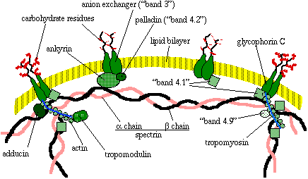
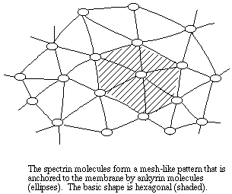
Erythrocytes - cytoskeleton
Notes:
http://www.ruf.rice.edu/~bioslabs/studies/sds-page/rbcmembrane.html

Slide 11
Erythrocytes - Hemoglobin
Notes:
http://en.wikipedia.org/wiki/Hemoglobin

Slide 12
Erythrocytes – Heme synthesis
Notes:
http://en.wikipedia.org/wiki/File:Heme-Synthesis-Chemical-Details-NEW.svg

Slide 13
Erythrocytes - Metabolism

Slide 14
Degradation of Heme

Slide 15
Iron cycle

Slide 16
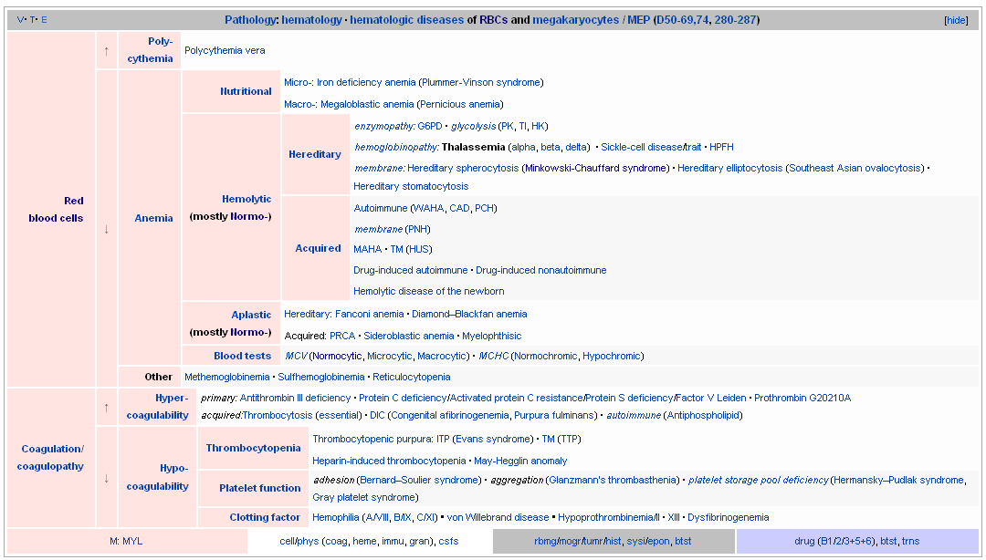
Erythrocytes - Pathology

Slide 17
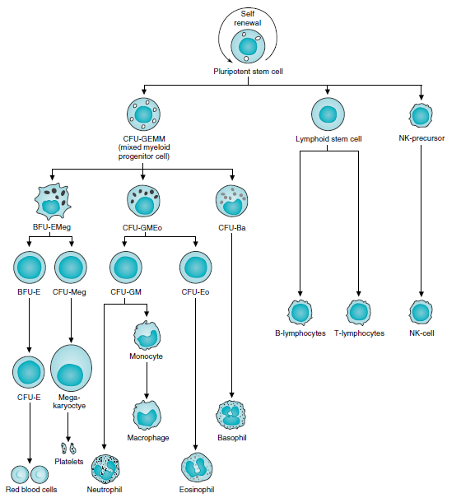
Hematopoietic tree
Notes:
CFU Colony Forming Unit; BFU Burst Forming Unit

Slide 18
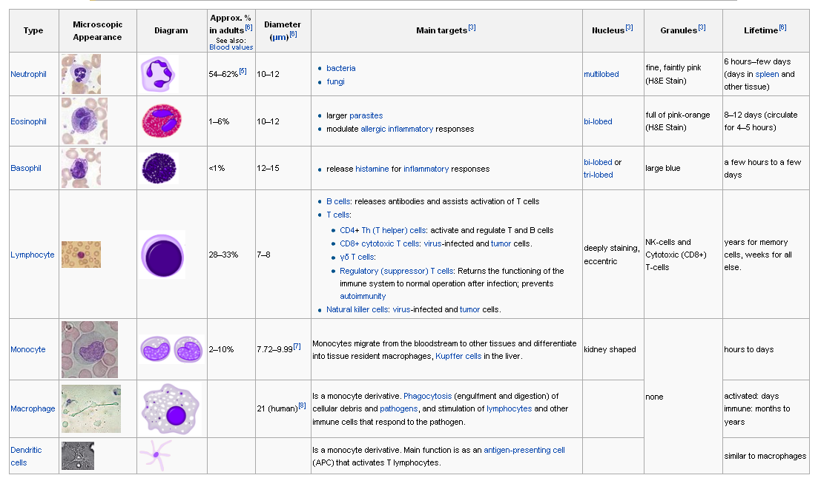
White Blood cells
Notes:
http://en.wikipedia.org/wiki/White_blood_cell

Slide 19
Fixed leukocytes
Histiocytes
Dendritic Cells
Mast Cells
Microglia
Kupffer Cells (liver)

Slide 20
Blood Coagulation

Slide 21
Blood Coagulation Cascade
Notes:
http://ep.bmj.com/content/96/2/49.abstract

Slide 22
Blood Coagulation – Vitamine K

Slide 23
Blood Coagulation - Fibrinolysis
Notes:
http://cs.wikipedia.org/wiki/Plazmin

Slide 24
Hemostasis Disorders

Slide 25
Literature
R.K. Murray et al.: Harper's Illustrated Biochemistry, twenty-sixth edition, McGraw-Hill Companies, 2003
Allan D. Marks, MD: Basic Medical Biochemistry a Clinical Approach, Lippincott Williams & Wilkins, 2009

