Slide 1
Biosynthesis and degradation of proteins
Bruno Sopko

Slide 2
Content
Proteosynthesis
Post-translation processing of proteins
Protein degradation

Slide 3
Proteosynthesis

Slide 4
Creation of Aminoacyl-tRNA
Amino acid + ATP ↔ Aminoacyl-AMP + Pp_{i}
Aminoacyl-AMP + tRNA ↔ Aminoacyl-tRNA + AMP
Summary:
Amino acid + ATP + tRNA ↔ Aminoacyl-tRNA + AMP + PP_{i}

Slide 5
Crystal structure of cysteinyl-trna
synthetase binary complex with trnacys:
Notes:
Shape-selective RNA recognition by cysteinyl-tRNA synthetase. Hauenstein, S., Zhang, C.M., Hou, Y.M., Perona, J.J., (2004) Nat.Struct.Mol.Biol. 11: 1134-1141

Slide 6
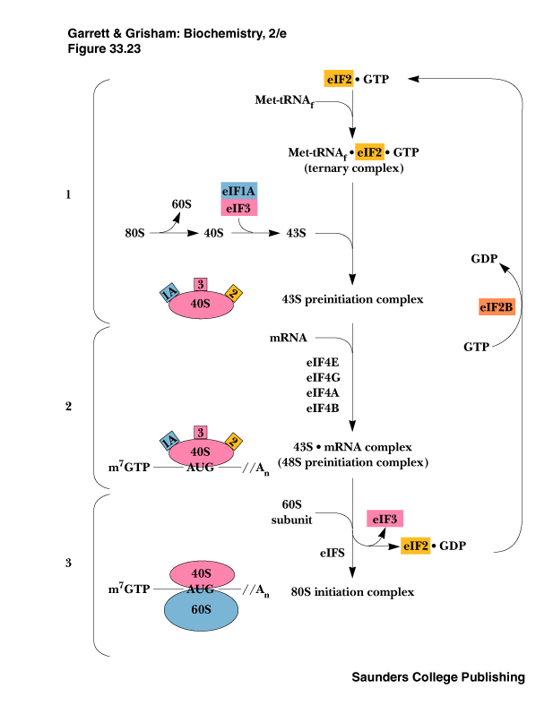
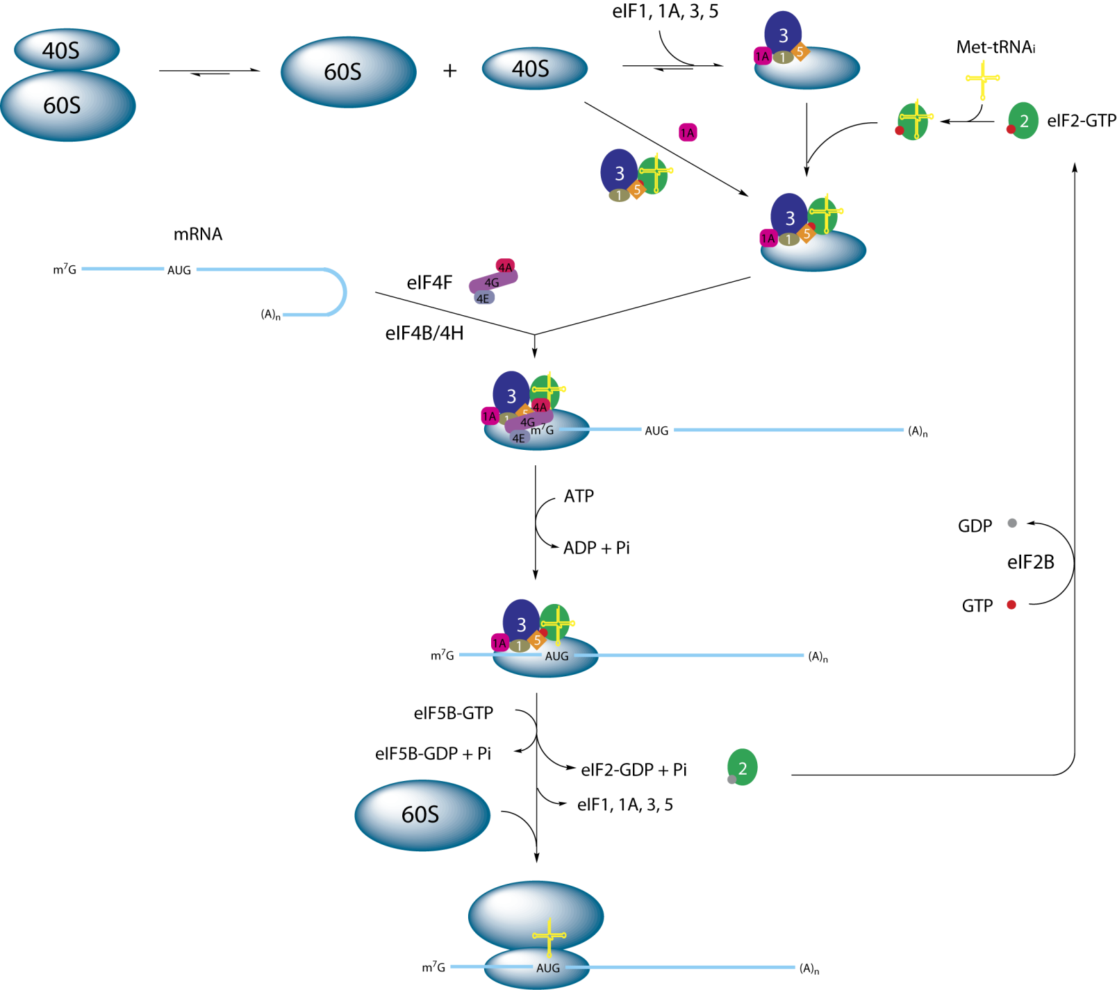
Proteosynthesis
initialization:
Notes:
http://en.wikipedia.org/wiki/File:Eukaryotic_initiation.png

Slide 7
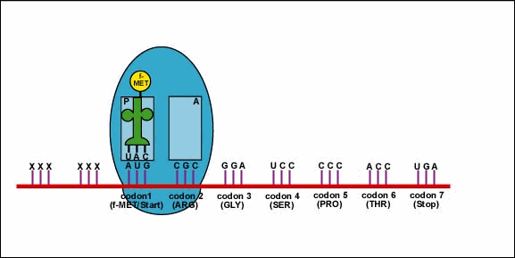
Elongation:
Notes:
Copyright © Gary E. Kaiser

Slide 8
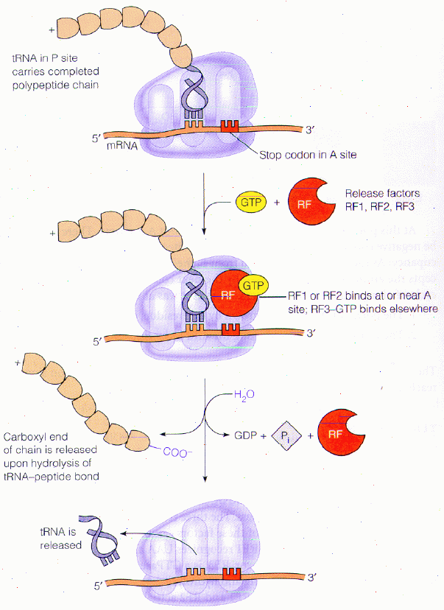
Protein synthesis
termination:
Notes:
http://bass.bio.uci.edu/~hudel/bs99a/lecture24/lecture5_5.html

Slide 9
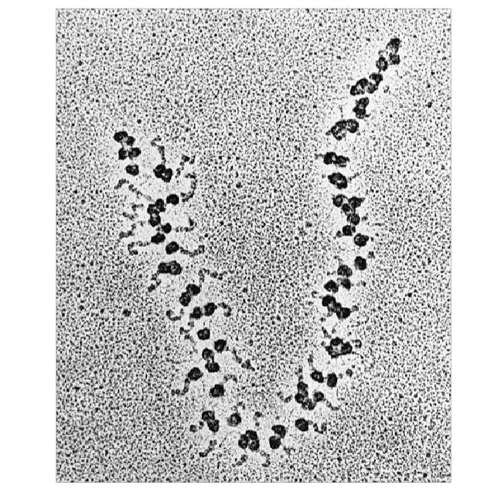
Electron microscopy
picture

Slide 10
Post-translation processing of proteins

Slide 11
Protein folding and role of chaperones
Secondary structure
Supersecondary motifs
Hydrophobic domains
Disulphide bonds (protein disulphide isomerase – PDI)
Proline (peptidyle proline isomerase – PPI)
Molecular chaperones are proteins that assist the
non-covalent folding or unfolding and the assembly or
disassembly of other macromolecular structures

Slide 12
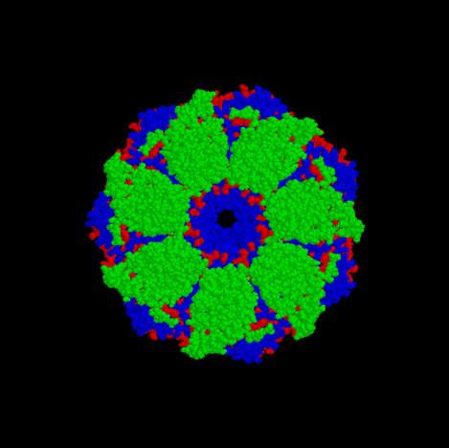
A top-view of the GroES/GroEL bacterial
chaperone complex model

Slide 13
Proteolytic modifications

Slide 14
Cotranslational translocation
Notes:
https://iwasa.hms.harvard.edu/project_pages/translocation/downloads/cotranslational_translocation.mov

Slide 15
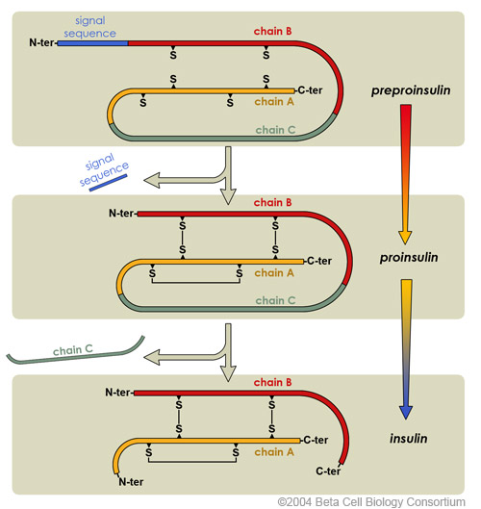
Insulin maturation
Notes:
http://upload.wikimedia.org/wikipedia/commons/7/7a/Insulin_Maturation.jpg

Slide 16
Glycosylation

Slide 17
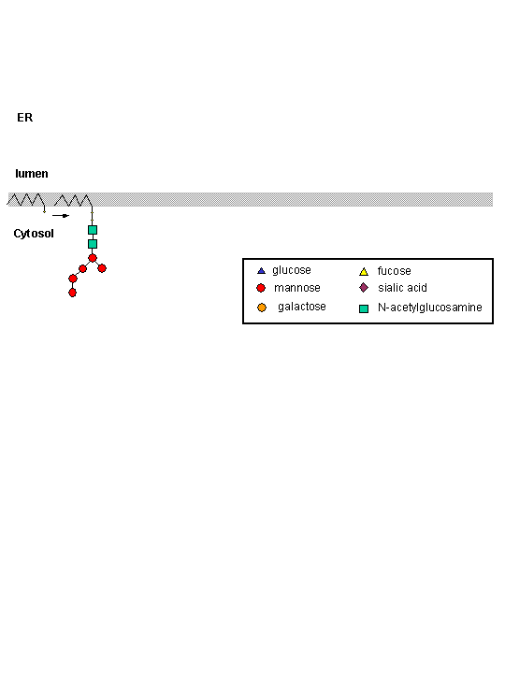
Notes:
http://employees.csbsju.edu/hjakubowski/classes/ch331/cho/eranimation.gif

Slide 18
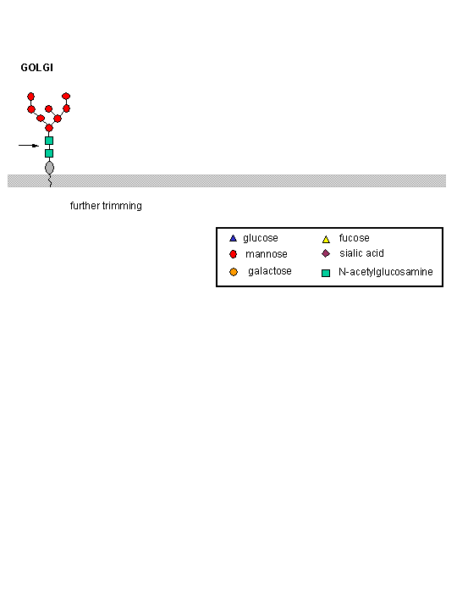
Notes:
http://employees.csbsju.edu/hjakubowski/classes/ch331/cho/golgianimation.gif

Slide 19
Other protein modification
Hydroxylation (hydroxyproline, hydroxylysine)
Methylation (mono- , di- and even trimethyllysine)
PHOSPHORYLATION
Carboxylation (γ-carboxyglutamate)
Acetylation
……..

Slide 20
Protein degradation

Slide 21
Proteases
Serine proteases (trypsin, chymotrypsin, elastase ….)
Aspartate proteases (pepsin, some proteases found in lysosomes, renin, HIV-protease …)
Metalloproteases (carboxypeptidases, various matrix metalloproteases …)
Cysteine proteases (papain, cathepsins, caspases, calpains …)

Slide 22
Protein degradation systems
Vacuolar (lysosomes, endosomes, ER, …)
Ubiquitine system (proteasome)

Slide 23
Ubiquitin pathway I.

Slide 24
Ubiquitin pathway II.
Notes:
http://www.hhmi.org/biointeractive/media/proteasome-lg.wmv

Slide 25
Activation of proteases
Most proteases are synthesized as larger pre-proteins. During activation, the pre-protein is cleaved to remove an inhibitory segment.
In some cases activation involves dissociation of an inhibitory protein
Activation may occur after a protease is delivered to a particular compartment within a cell or to the extracellular milieu.
Caspases involved in initiation of apoptosis are activated by interaction with large complexes of scaffolding and activating proteins called apoptosomes.

Slide 26
Protease inhibitors
IAPs are proteins that block apoptosis by binding to and inhibiting caspases. The apoptosis-stimulating protein Smac antagonizes the effect of IAPs on caspases.
TIMPs are inhibitors of metalloproteases that are secreted by cells. A domain of the inhibitor protein interacts with the catalytic Zn⁺⁺.
Cystatins are inhibitors of lysosomal cathepsins. Some of these (also called stefins) are found in the cytosol and others in the extracellular space. Cystatins protect cells against cathepsins that may escape from lysosomes.
Serpins are widely distributed proteins that utilize a unique suicide mechanism to inhibit serine or cysteine proteases. A large conformational change in the serpin accompanies cleavage of its substrate loop. This leads to disordering of the protease active site, preventing completion of the reaction. The serpin remains covalently linked to the protease as an acyl-enzyme intermediate.
Non-specific: α₂-macroglobulin

